Slide 1
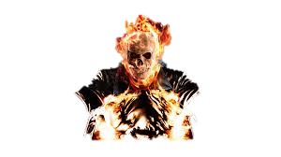
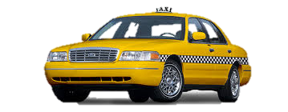
GLITCHY TAXI FEAT. GHOST RIDER
Rahul Anand
Ryan Noeske

Slide 2
Backstory
One day, the Ghost Rider was driving an invisible taxi along a highway when all of a sudden, the highway and everyone on it was struck by lightning. This caused him and his taxi to become solid and vulnerable to damage. In addition, his invisibility became compromised, for he would randomly flash visible at times. To make matters worse, the other cars’ headlights were fried by the lightning, effectively making them invisible as well, though they still cast shadows over the road. To top of the list of disasters, the Ghost Rider is driving on the wrong side of the road. You must play as the Ghost Rider and avoid the oncoming vehicles for as long as possible. This game will test whether you can keep track of multiple invisible objects at the same time.

Slide 3
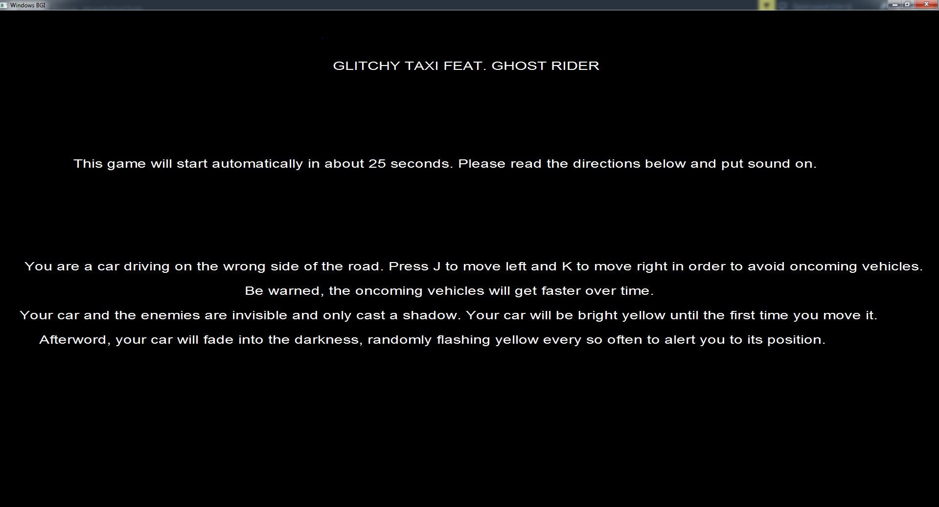
OUR OPENING SCREEN

Slide 4
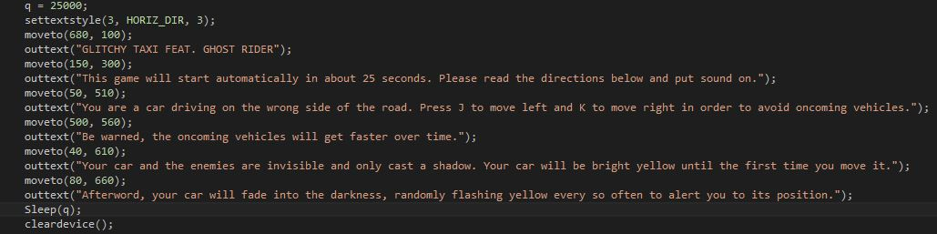
How we got the opening screen and screen delay to work
This code is used to create the opening screen. The sleep function is used to give the player time to read the instructions and to provide a 25-second buffer before the game begins.

Slide 5
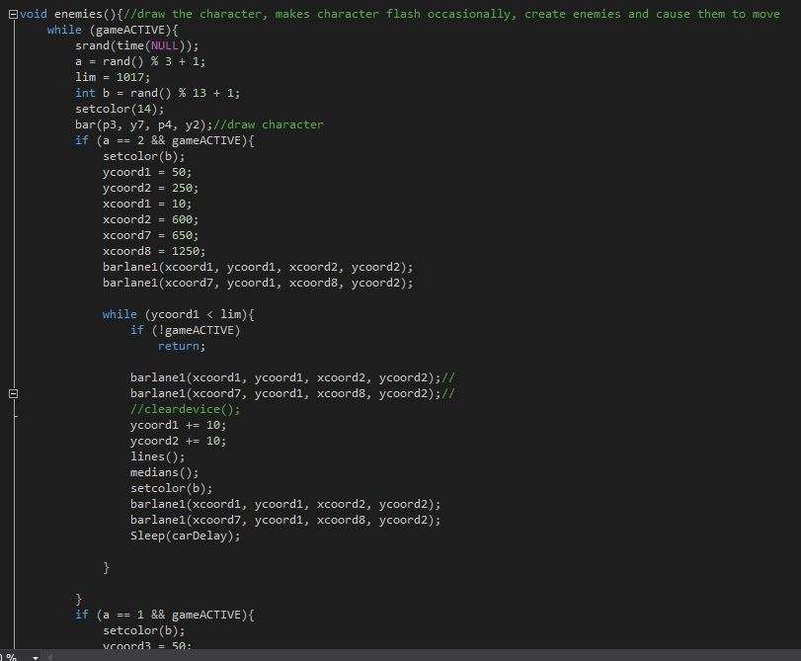
The backbone of our game
The bool gameACTIVE is used to allow the rest of our threads to function and be ended at our choosing.
Without it, we would not be able to run and close our threads as effectively.
gameACTIVE initializing and closing threads

Slide 6
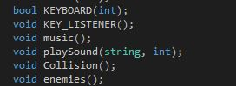
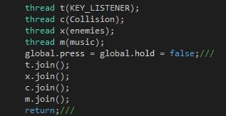
The Threads We Used
We had a thread for the key listener, music, drawing of shapes, and collision detection.

Slide 7
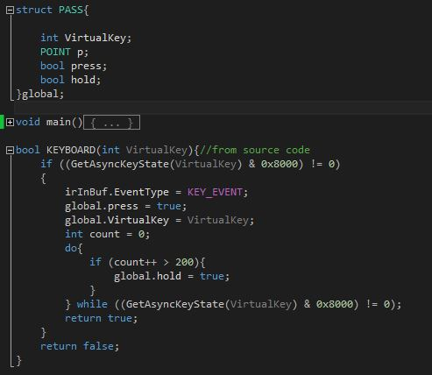
The Key Listener
This defines a press and hold using structs

Slide 8
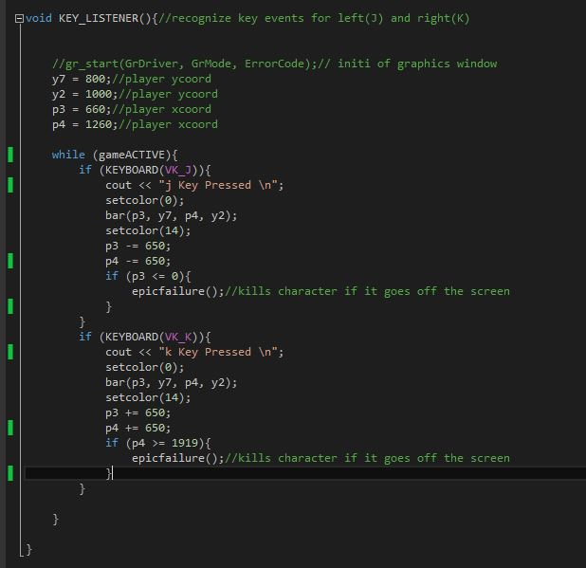
The Key Listener Cont.
Shifts the character left while covering the old character with blackness.
Shifts the character right while covering the old character with blackness.

Slide 9
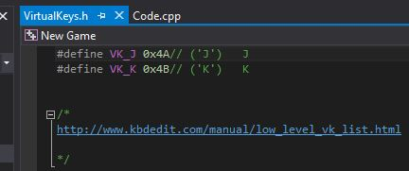
VirtualKeys.H
We used virtual keys so that we could define the keys “J” and “K” for moving the character left and right, respectively.

Slide 10
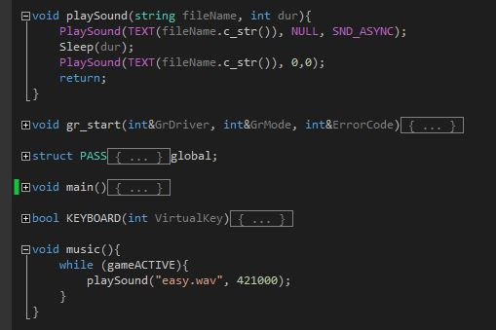
Music
We included the song Kipod by Infected Mushroom in our code.
The reason we chose this was because it starts out slow and increases in speed as the enemy cars get faster. This helps create a tense mood.
This is the playSound function that we used.
This is the actual music thread that plays the sounds.

Slide 11
The Drawing Thread
To be honest, this thread is called enemies because it was initially made to just draw the enemy cars and we were too lazy to change the name after making it into a draw thread.
The only constant part in this thread is the drawing of the lane boundaries and dashed center lines.
We created the functions “lines” and “medians” to do this.
The rest of the code is dedicated to drawing the character’s taxi and getting it to occasionally flash yellow as well as drawing the enemy cars in random pairs.

Slide 12
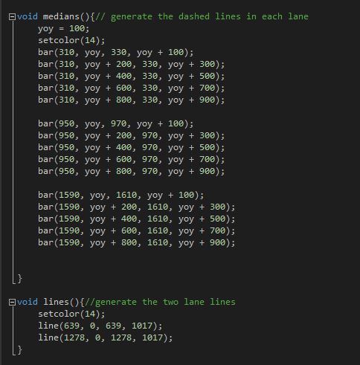
The Drawing Thread (Lines and Medians)
Below is the code for the lines and medians function.
A lot of bars were used in the making of this game for additional visual touches. However, this game does not discriminate based on shape, color, size, etc.

Slide 13
The Drawing Thread (Enemies and Taxi)
The code below shows a single instance that draws the enemy rectangles along with the character, lines, and medians. In reality, there are three such instances that occur randomly.
Random #s
Draw taxi
Draw enemies

Slide 14
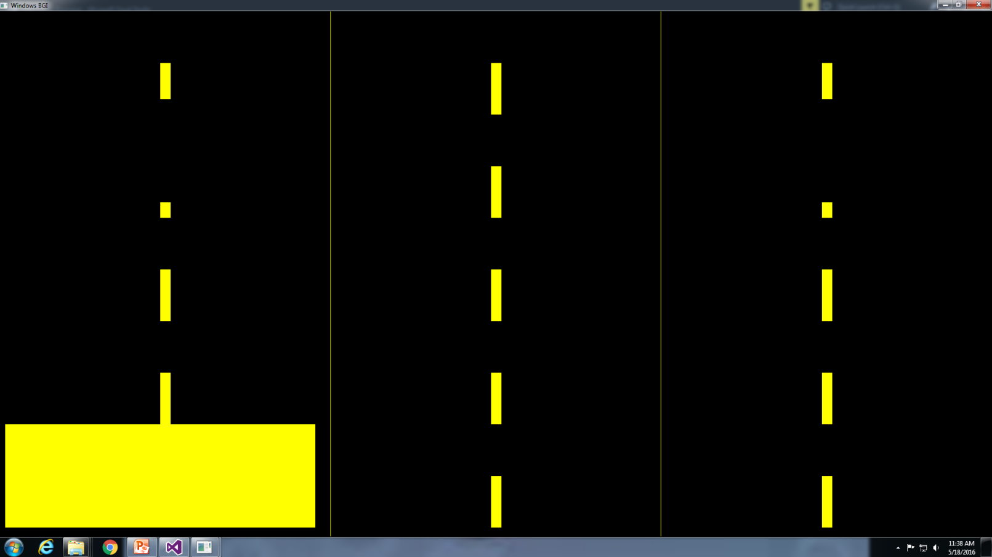
How this all Looks
Yes, there is little to see from a first look, but that is because the game is based almost entirely off what you DON’T see.
Cars are here

Slide 15
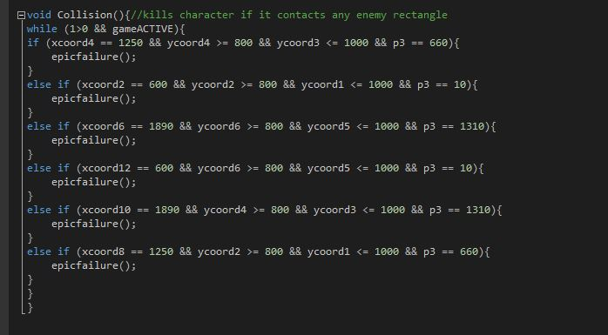
The Collision Thread
This thread kills the character if it contacts an enemy car.
The character can also be killed if it goes off the screen, as seen in the Key Listener.

Slide 16
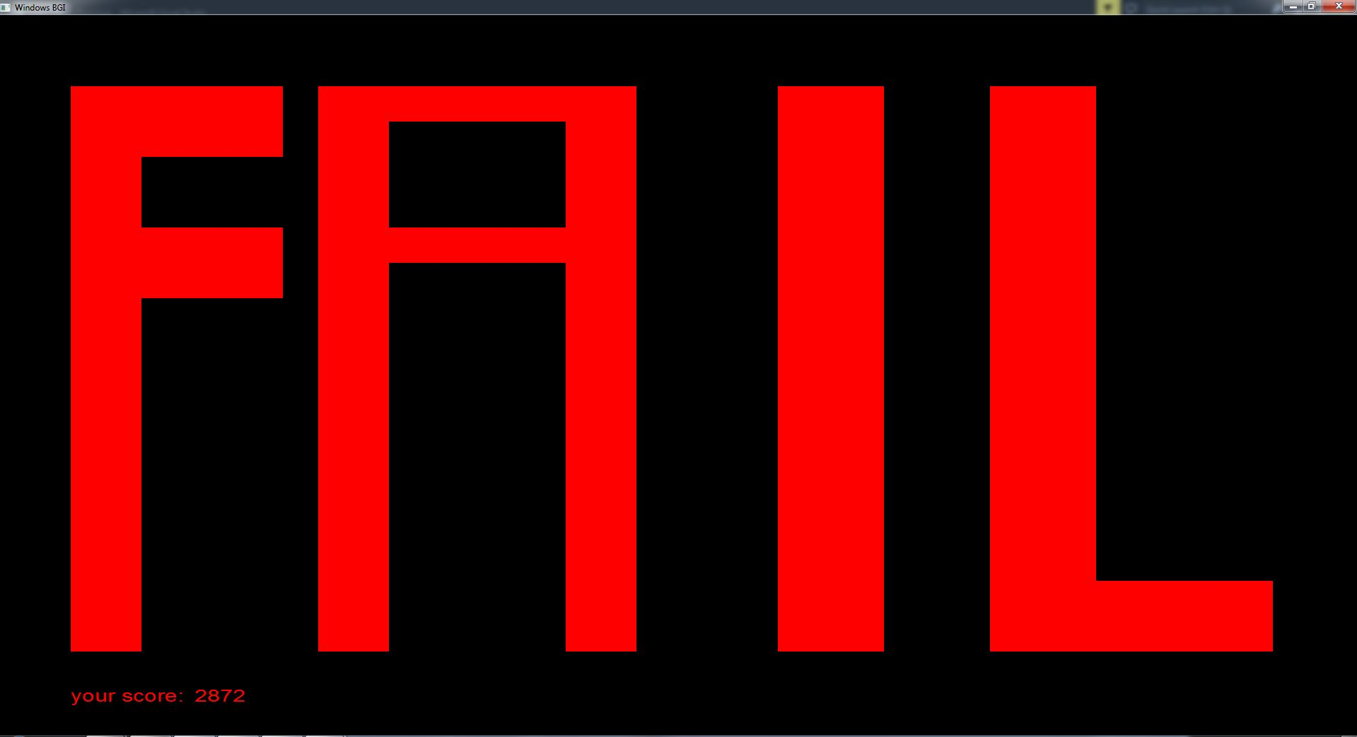
In the Event of Death…
EPIC FAILURE. You obviously don’t have the skills needed to be the Ghost Rider.
The screen below pops up, followed by the sound effects of a car skidding and exploding. Then, your score is displayed in the bottom left corner.

Slide 17
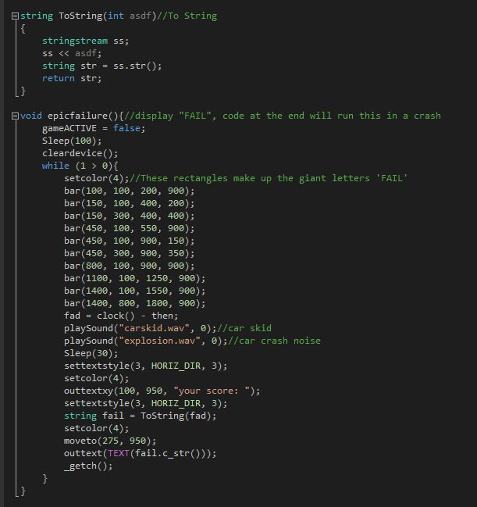
How this works
There is a function called epicfailure that creates this entire sequence.
ToString Function
Kills gameACTIVE to end threads
Displays FAIL in block letters
Play car skid and explosion sound effects
This converts the score, which is calculated using time elapsed in ms, into a string so that it can be displayed. The ToString function is pivotal for this to work.

Slide 18
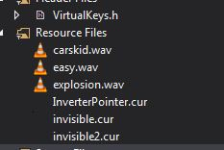

Invisible Cursor
To top off our list of finishing touches, we made our cursor invisible.
This is the invisible cursor we used

Slide 19
Difficulties we had
We had initially attempted to create the enemy cars to be visible, but quickly realized that the redrawings were overlapping, creating colored bars on the roads that weren’t supposed to be there. In addition, the game was too easy when the player could see the enemies, and anyone would attain a very good score.
To correct this, we made it so that the slightest mistake could mean death due to the inivisibility of the player and the enemies.
In addition, our code was crashing and burning without the bool gameACTIVE, which stabilized our initialization and ending of threads.
We also had trouble implementing the ToString function, but Mr. Hudson helped us get that to work correctly without crashing.
Our final problem was that the many goto statements we initially had were causing the game to glitch, but we managed to remove those and replace them with other functions.

Slide 20
Time Management
We had very few problems with time management, working hard and being productive until we finished last week.
After that, we had more free time because we only had to do bug fixes, run trials, and add finishing touches such as the car skidding sound effect.
We divided the workload pretty evenly.
While Rahul started off with the base coding, Ryan found the musical files we needed and helped prepare them for later addition into the code.
Afterword, all coding was done collectively as a group.

